Slide 1

Let’s up GDP

Slide 2
“ANALYSIS OF GDP”
The Team comprises of:
Yogesh Kerkar
Nikhil Pokharkar
Jitendra Dalavi
Prashant Kalebag
Ganesh Walimbe
Under The Guidance of:
Ms. Sheetal L. Chabukswar

Slide 3

INTRODUCTION
Gross Domestic Product (GDP) is the money value of all final goods and services produced for sale within an economy over one year. It provides an economic snapshot of a country, used to estimate the size of an economy and growth rate. Though it has limitations, GDP is a key tool to guide policy-makers, investors, and businesses in strategic decision-making. The GDP of a country tends to increase when the total value of goods and services that domestic producers sell to foreign countries exceeds the total value of foreign goods and services that domestic consumers buy. Gross domestic product indicates three significant figures in a country's economy vision, which are national income, national output, and the national expenditure GDP effects some important issues in a country like; unemployment, standard of living, and investment.
So throughout this project we will get to know some interesting facts and insights

Slide 4

Why we Choose this topic
The main reason behind the selection of this topic is that most of the people are just known about the word GDP but they don’t have any idea about how it is calculated, which are the main factors that are affecting the country’s GDP, how does it affect on global economy, what changes will happen in global economy if GDP of a country will increase or decrease.
Through this project we want to aware people about country’s GDP.

Slide 5
METHEDOLOGY
Defining objectives
Data cleaning
Introduction of data
Coding of data

Slide 6
.
Analysis of data using various statistical packages
Interpretation of results
Conclusion

Slide 7

Data Source
Secondary data:
The World data bank
https://data.worldbank.org/

Slide 8
Introduction to data
The data consist of 178 countries
Total no of variables : 15
Dependent variable :
GDP per capita
Independent variables :
Agriculture, forestry, and fishing
Land area (sq. km)
Death rate, crude (per 1,000 people)
Birth rate, crude (per 1,000 people)
Industry (including construction)value added
per worker (constant 2015 US$)
Mobile cellular subscriptions (per 100 people)
Region
PoMortality rate (per 1,000 live births)
population total
Services value added (constant 2015 US$)
Exports of goods and services (constant 2015 US$)
Imports of goods and services (constant 2015 US$)
Population density (people per sq. km of land area)
Country name

Slide 9

Data cleaning
There are total 110 missing values in the data
The variable which consist missing values are :
Agriculture, Exports, Imports, Industry, Land area, Mobile, Mortality rate, Population density, Services.
To check if there are any outliers we plot boxplot

Slide 10
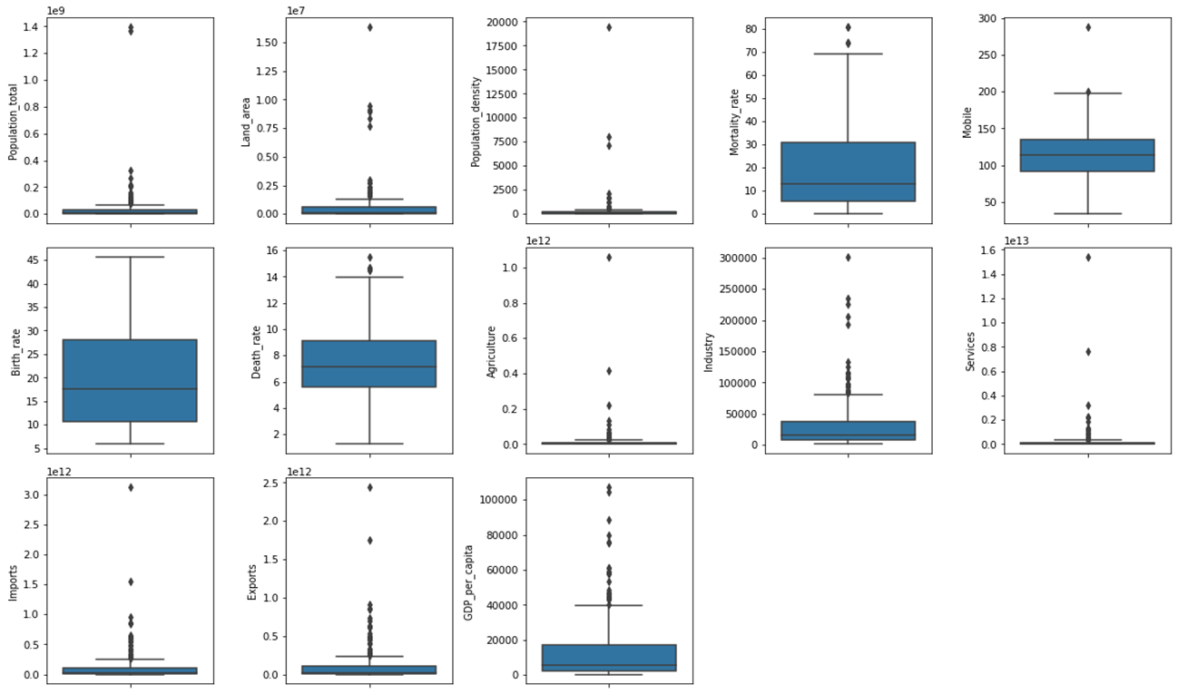

Slide 11
Filling missing values
Observations from boxplot :-
Birth rate do not have any outliers.
Mortality rate, Mobile and death rate has low amount of outliers .
Population total ,land area ,population density, agriculture, industry, services, imports, exports, GDP per capita has significant amount of outliers.
Therefore the variables containing outliers are filled with median on the basis of the country region.

Slide 12

OBJECTIVES
To identify the various factors that affecting the GDP of a country.
Estimate the top factors that highly correlated with GDP.
To compare the Economy structure for the ten countries with highest total GDP.
To Build a predictive model based on important factors.

Slide 13
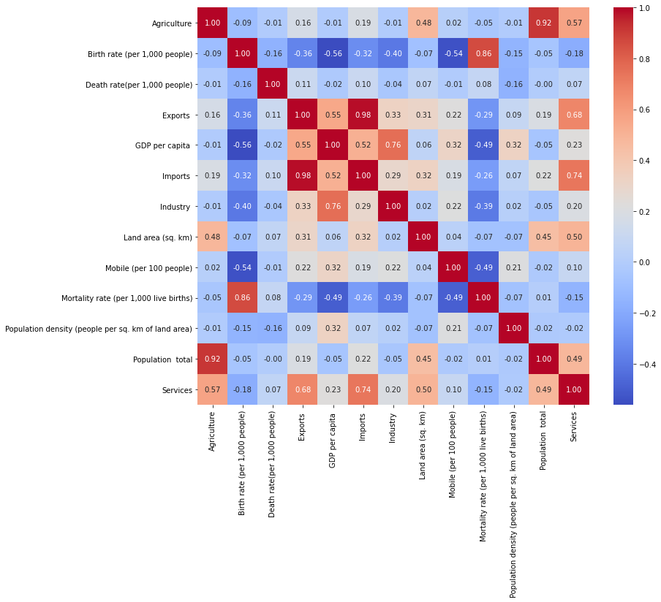
Correlation Metrics

Slide 14

Identifying top factors highly correlated with GDP per capita
From correlation matrix we can see that :-
GDP per capita and birth rate are moderately negatively correlated with each other with corr=-0.56
GDP per capita and exports are moderately positively correlated with each with corr=0.55
GDP per capita and imports are moderately positively correlated with each other with corr= 0.52
GDP per capita and industry are strongly positively correlated with each other with corr=0.76
GDP per capita and mobile subscription have weak positive correlation with each other with corr=0.32
GDP per capita and mortality have weak negative correlation with each other with corr=-0.49
GDP per capita and population density have weak positive correlation with each other with corr=0.32
GDP per capita and services have weak positive correlation with each other with corr=0.23
There is negligible amount correlation between GDP per capita and agriculture, death rate, land area and population total .

Slide 15
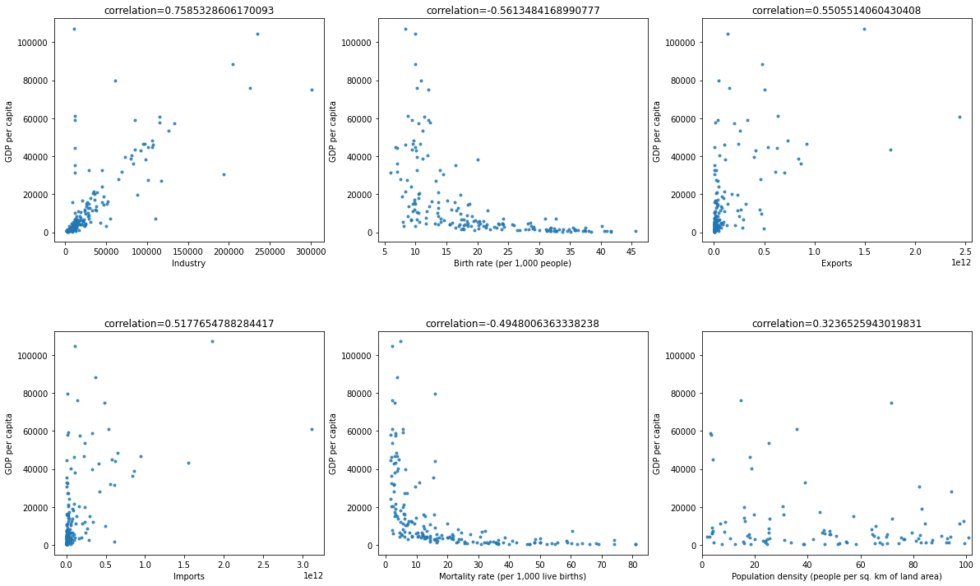
To identify the factors that affecting GDP of country

Slide 16
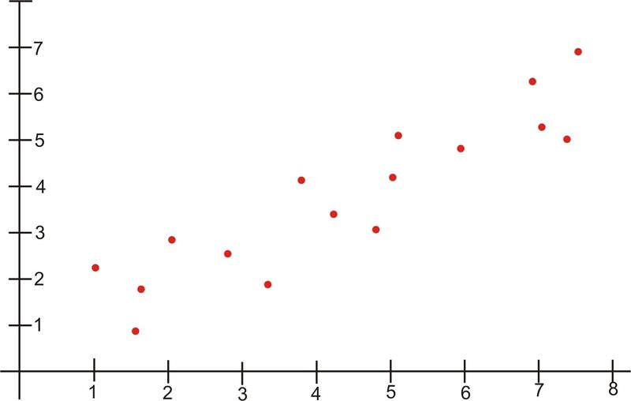
Top factors affecting GDP of a country are
Industry
Birth rate
Exports
Imports
Mortality rate
Population density

Slide 17
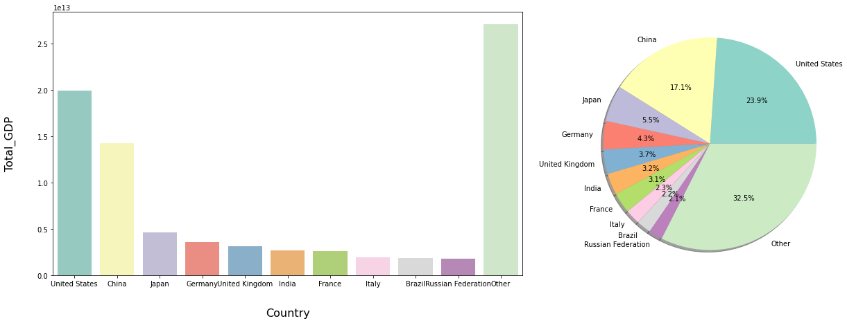
Top Ten Countries with highest Total GDP

Slide 18
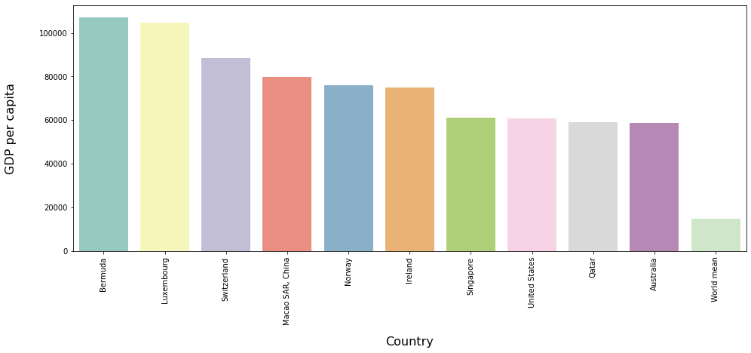
Top 10 Countries with highest GDP per capita

Slide 19
Rank of GDP per capita - Rank of Total GDP:
Country Difference in Ranks United States 7 United Kingdom 11 Germany 17 France 18 Italy 23 Japan 24 Russian Federation 49 Brazil 61 China 64 India 130

Slide 20
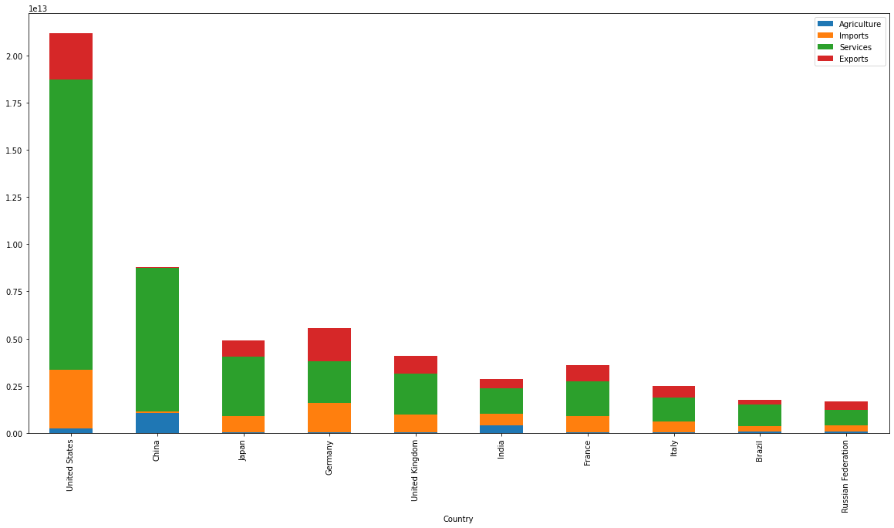
Economy Structure of Top 10 countries having high total GDP

Slide 21
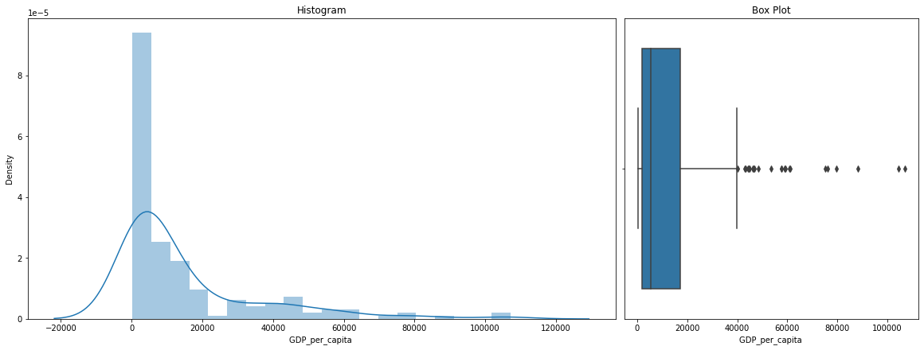
To check whether target variable follows normal distribution

Slide 22
Skewness and kurtosis of GDP per capita:-
Skewness: 2.139997
Kurtosis: 4.729215
Observations:
From histogram and boxplot we can say that our target variable, GDP per Capita is not normally distributed.
Our target variable is right-skewed.
There are significant amount of outliers in the variable.

Slide 23
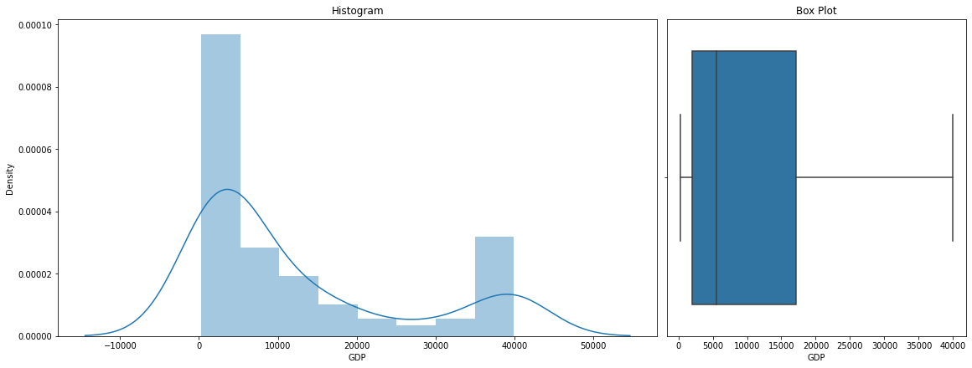
After removal of Outliers

Slide 24
Skewness and kurtosis of GDP per capita:- Skewness: 1.722124 Kurtosis: 2.339446 Observations: From histogram and boxplot we can say that our target variable, GDP per Capita is not normally distributed. Our target variable is right-skewed.

Slide 25


